Slide 1
A particle filter estimate of COVID-19 infection rates on a college campus
Michael Falkenheim

Slide 2
Outline of talk
Covid-19 and residential colleges in the fall of 2020
Some general thoughts on particle filters and when they might be useful.
Demonstration of particle filters with Boston University infection rates:
Initializing with a prior distribution
Updating with new data (filtering)
Calculating likelihood of data (for use in MLE)
Smoothing
Python open source tools on GitHub.
Warning: I am a user of particle filters but not really an expert.

Slide 3


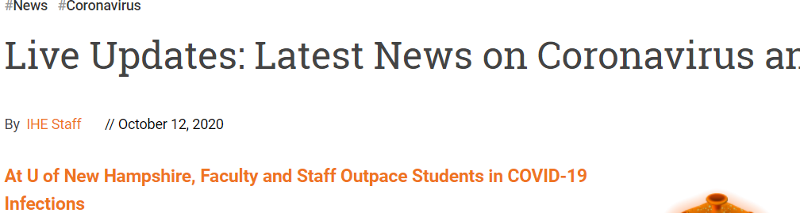
Debate over college reopening

Slide 4
CDC Guidelines for Higher Education
Lowest Risk
Faculty and students engage in virtual-only learning options, activities, and events.
Some Risk
Hybrid learning model: in-person learning is limited to courses and laboratory instruction that cannot be delivered remotely.
Medium Risk.
Hybrid learning model: Students participate in a mix of virtual learning and in-person learning for all courses. Dine outdoors, limit social gathering
High Risk.
More or less business as usual
All levels: disinfect stuff, test people when they are sick, isolate them if they have Covid-19, discourage or prohibit large social gatherings, Test students upon arrival on campus.

Slide 5
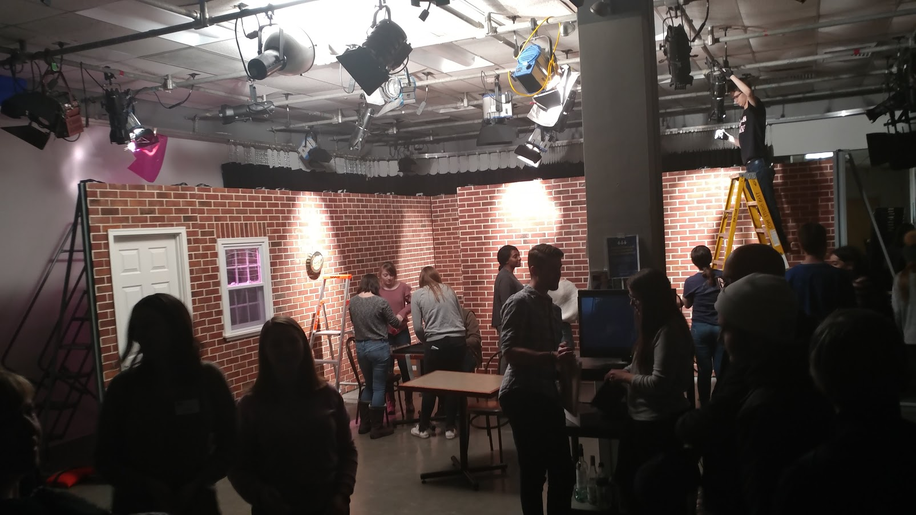
Why study BU? My daughter is at film school there.

Slide 6
Boston University’s Approach
In some ways the approach is consistent with CDC “medium risk”: All courses have some element of in-person instruction.
Large social gatherings prohibited with heavy penalties for infractions
Masks required at all times
Dining grab and go – and students encouraged to eat outside as long as weather suitable
PLUS
Mandatory twice a week testing of everyone (they make the tests)
Students must check symptoms and report in app each day
Isolation housing for those who test positive

Slide 7
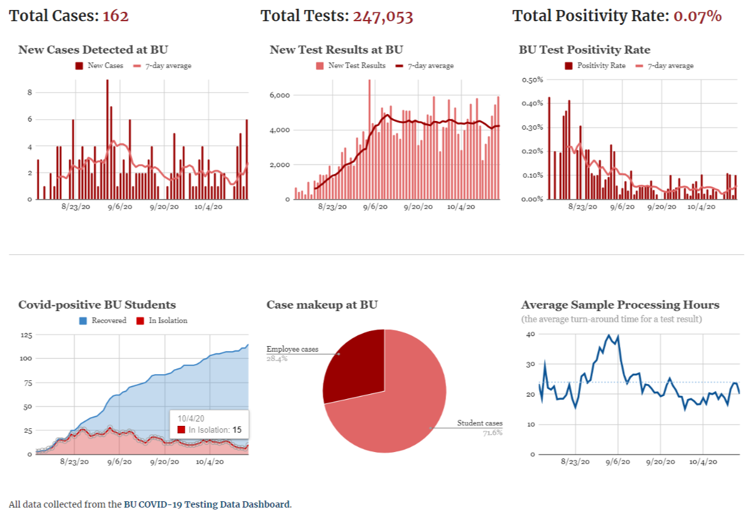
BU Covid-19 Dashboard (so far so good)

Slide 8
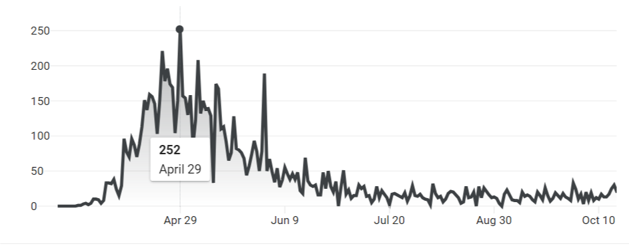
It helps that MA is past its darkest hour (deaths /day)

Slide 9
Background on Particle Filters

Slide 10
General approach
Particle filters use a “swarm” of particles to approximate the distribution of unobserved variables of interest.
A particle is a set possible coordinates for those variables.
Particles are reweighted (given higher or lower probability) according to Bayes’s rule using the likelihood of the observed data conditional on that particle’s coordinate being the true location.
Importance sampling (survival of the fittest particles) is a key element of the algorithm.
Particle filtering is a Monte Carlo algorithm but not the only one used for Markov Chains. There is another Monte Carlo algorithm called the Hastings-Metropolis algorithm which relies on random steps.

Slide 11
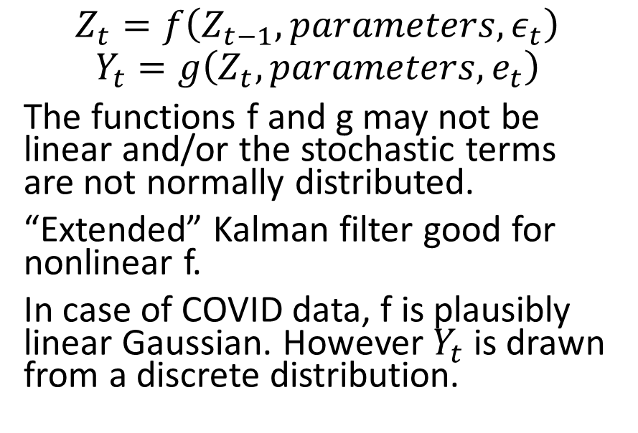
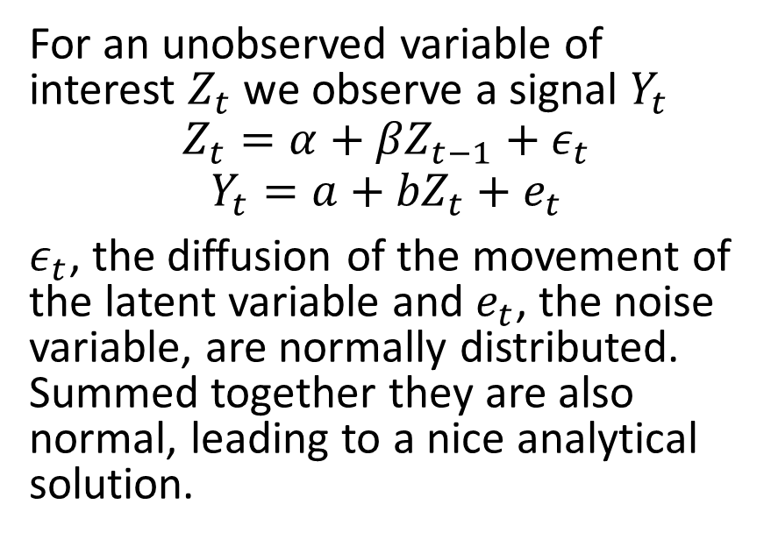
Particle filters versus other filters
Kalman filter model: linear Gaussian
More difficult to estimate model: nonlinear and/or non Gaussian
For an unobserved variable of interest $Z_{t}$ we observe a signal $Y_{t}$
$$Z_{t}={α+βZ}_{t−1}+ε_{t}$$
$${Y_{t}=a+bZ}_{t}+e_{t}$$
$ε_{t}$, the diffusion of the movement of the latent variable and $e_{t}$, the noise variable, are normally distributed. Summed together they are also normal, leading to a nice analytical solution.
$$Z_{t}=f\left(Z_{t−1},parameters,ε_{t}\right)$$
$$Y_{t}=g\left(Z_{t},parameters,e_{t}\right)$$
The functions f and g may not be linear and/or the stochastic terms are not normally distributed.
“Extended” Kalman filter good for nonlinear f.
In case of COVID data, f is plausibly linear Gaussian. However $Y_{t}$ is drawn from a discrete distribution.

Slide 12
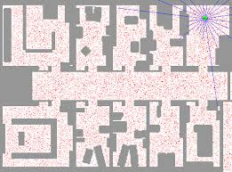
Applications of Particle Filters
Data science / Engineering: where is the robot?
Economics
Fernández-Villaverde, Jesús, and Juan F. Rubio-Ramírez. "Estimating macroeconomic models: A likelihood approach." The Review of Economic Studies 74.4 (2007): 1059-1087.

Slide 13
Steps in particle filtering
Draw particles from prior distribution.
Project particles into next period.
Add diffusion.
Calculate weight for each particle based the likelihood of observed data in that period condition on the location of the particle (Bayes). (These likelihoods can also be used to estimate parameters under MLE). Use weights to calculate mean and so on.
Resample particles based on weights (importance sampling)
Repeat steps 2 to 5 until you reach last observation.
Backwards smoothing (if desired).

Slide 14
Step 1: Initialize prior distribution
Assume (arbitrarily for now) that the infection rate upon arrival is drawn from a uniform distribution U(0, k). Let’s make k = 0.01. “Students arriving at BU had an infection rate between zero and one percent.”
Draw a bunch of particles randomly from the U(0, 0.01) distribution.
Given them equal weight.
Particle # | Infections rate time 0
1 | 0.0013
2 | 0.0058
3 | 0.0024
4 | 0.0084
5 | 0.0064
6 | 0.0068
7 | 0.0004
8 | 0.0073
9 | 0.0098
10 | 0.0042

Slide 15
Step 2: Projected movement
Project forward infection rates based on a simple epidemiological model.
I assume a rate of transmission (Rt=0.4) and serial interval (6 days). This leads to exponential growth/shrinkage of infection rates. In this case a daily shrinkage factor of 0.9.
But assume that 0.0002 infections are imported from outside campus.
Particle # | infection day 0 | projection day 1
1 | 0.0013 | 0.0013
2 | 0.0058 | 0.0054
3 | 0.0024 | 0.0023
4 | 0.0084 | 0.0078
5 | 0.0064 | 0.0060
6 | 0.0068 | 0.0063
7 | 0.0004 | 0.0006
8 | 0.0073 | 0.0068
9 | 0.0098 | 0.0090
10 | 0.0042 | 0.0040

Slide 16
Step 3: Diffusion: “let’s make some noise!”
Assume that infection rate is gamma distributed with an expected value equal to the projection (from last step) and a shape parameter (which determines the variance.
Gamma distributions are commonly used for this sort of thing (as discussed later) by actuaries.
Particle # | projection day 1 | Infection day 1
1 | 0.0013 | 0.0018
2 | 0.0054 | 0.0027
3 | 0.0023 | 0.0021
4 | 0.0078 | 0.0041
5 | 0.0060 | 0.0042
6 | 0.0063 | 0.0122
7 | 0.0006 | 0.0004
8 | 0.0068 | 0.0138
9 | 0.0090 | 0.0093
10 | 0.0040 | 0.0036

Slide 17
Step 4: Calculate weight of each particle using data point and Bayes.
Particle number | Infection Rate | Expected positive for 5000 tests | Likelihood of 2 positives
1 | 0.0018 | 8.9 | 0.0052
2 | 0.0027 | 13.3 | 0.0001
3 | 0.0021 | 10.5 | 0.0015
4 | 0.0041 | 20.3 | 0.0000
5 | 0.0042 | 20.8 | 0.0000
6 | 0.0122 | 61.1 | 0.0000
7 | 0.0004 | 1.9 | 0.2698
8 | 0.0138 | 69.0 | 0.0000
9 | 0.0093 | 46.5 | 0.0000
10 | 0.0036 | 18.2 | 0.0000
For each particle calculate the expected positive tests given the infection rate and number tested.
For example if 5000 tests are done in a day a particle at 0.0007 infection rate would result expected positives = 3.5
Calculate weight based on likelihood of actual data point with lamda = expected positive tests. Suppose actual positives = 2.
Poisson(2|3.5) = 0.185

Slide 18
Step 5: Importance Sampling
Top ten particles (in terms of likelihood)
Many particles end up with next to zero weight after wandering away from the data points. Continuing to use the same particles and reweighting them would lead to a degenerate distribution.
Resampling the particles based on their weights solves this problem.
Repeat steps 2-5 until you reach last data point.
Particle number | Infection Rate | Likelihood of 2 positives | Scaled Weight (Likelihood of being drawn)
7 | 0.00038 | 0.2698 | 0.1276
17 | 0.00078 | 0.1539 | 0.0728
18 | 0.00035 | 0.2654 | 0.1255
21 | 0.00027 | 0.2370 | 0.1121
64 | 0.00083 | 0.1361 | 0.0644
66 | 0.00079 | 0.1511 | 0.0714
83 | 0.00092 | 0.1054 | 0.0498
86 | 0.00065 | 0.2039 | 0.0965
95 | 0.00083 | 0.1360 | 0.0643
96 | 0.00094 | 0.1013 | 0.0479

Slide 19
Two digressions: Likelihood of data; negative binomial distribution as Gamma Poisson Mixture
Likelihood estimation
Negative-binomial distribution
Given n particles with equal weight, the approximate likelihood of the data is the average likelihood under each particle.
For example average from two slides ago is 0.027
The likelihood of all data points is the product of those calculations for each data point.
This approximation of likelihood can be used for estimation of the parameters.
If the number of positives is Poisson conditional on lamda, and lamda is Gamma distributed, then the unconditional distribution of the number of positive is negative binomial.
Actuaries seem to love the negative binomial distribution.
Poisson is a good approximation of binomial distribution for low p events.
I can make the likelihood approximation slightly better using the negative binomial in place of the approach described on the left.

Slide 20
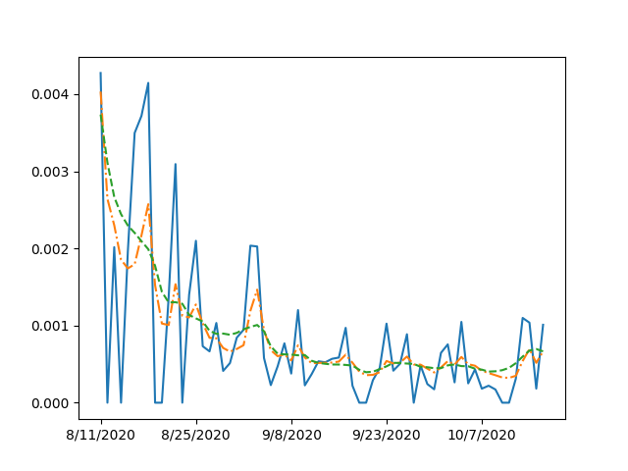
Filtering versus smoothing estimate

Slide 21
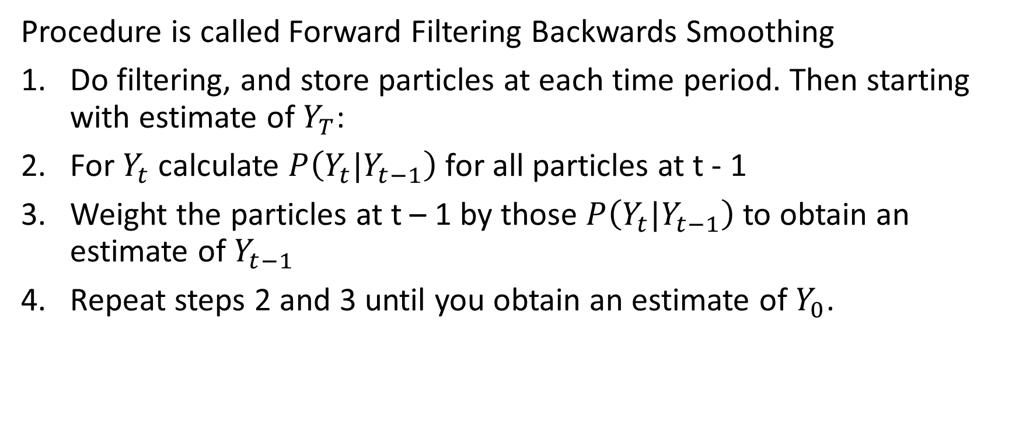
How to get the smoothing estimate (work backwards)
Procedure is called Forward Filtering Backwards Smoothing
Do filtering, and store particles at each time period. Then starting with estimate of $Y_{T}$:
For $Y_{t}$calculate $P\left(Y_{t}|Y_{t−1}\right)$ for all particles at t - 1
Weight the particles at t – 1 by those $P\left(Y_{t}|Y_{t−1}\right)$ to obtain an estimate of $Y_{t−1}$
Repeat steps 2 and 3 until you obtain an estimate of $Y_{0}$.

Slide 22
Maximum Likelihood Estimates for process generating BU Covid-19 infections
Parameter | Estimate | Interpretation
Upper limit of prior distribution | 0.77% | A fraction of a percent of students arrived with infections
R0 for infections on campus | 0.29 | Mitigation measures have East Asian degree of success
Daily rate of importation of infections from Boston | 0.04% | Exposure to other Bostonians seeds infections
Shape parameter for gamma distribution | 19.2 | Daily standard deviation of infection rate about one quarter of expected value

Slide 23
Python resources for particle filters
I used “pfilter” which required its users to define four functions (prior, projection, diffusion, weighting) and did most of the rest.
Pfilter does not do maximum likelihood or smoothing,
“pyParticleEst” does maximum likelihood and smoothing and generally seemed to have more bells and whistles (e.g. using advanced more efficient smoothing techniques) but was less intuitive (in my view)
Nordh, J. (2017). pyParticleEst: A Python framework for particle-based estimation methods. Journal of Statistical Software, 78(1), 1-25.

Slide 24
You won’t want to miss
Just Another Manic Monday podcast. To counter the negative health effects of college life, Sophie and her roommates do weeklong wellness challenges such as sleeping on the same schedule every day for a week "so that you don't have to." On the podcast they tell their audience how it went and what they learned. Available on Anchor, Spotify and many other media.
BUTV10’s election coverage. Sophie will serve on a three person panel of student pundits. (her views are her own).

